Slide 1
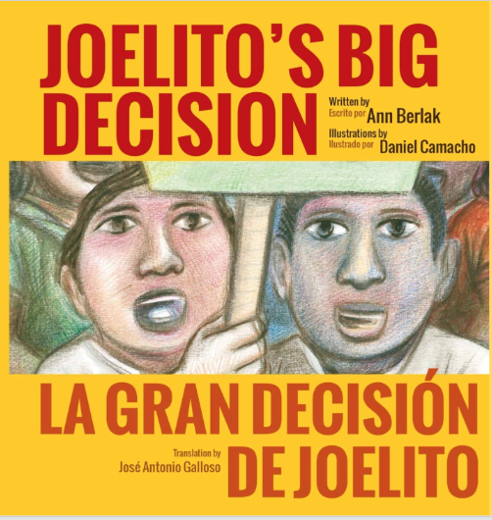

Rights Unit Cycle 2:
Joelito's Big Decision
La Gran Decisión De Joelito

Slide 2

Our Big Questions
What does fair treatment look
like?
How can people stand up for
their rights?
What can people do to change
things that are unfair?

Slide 3
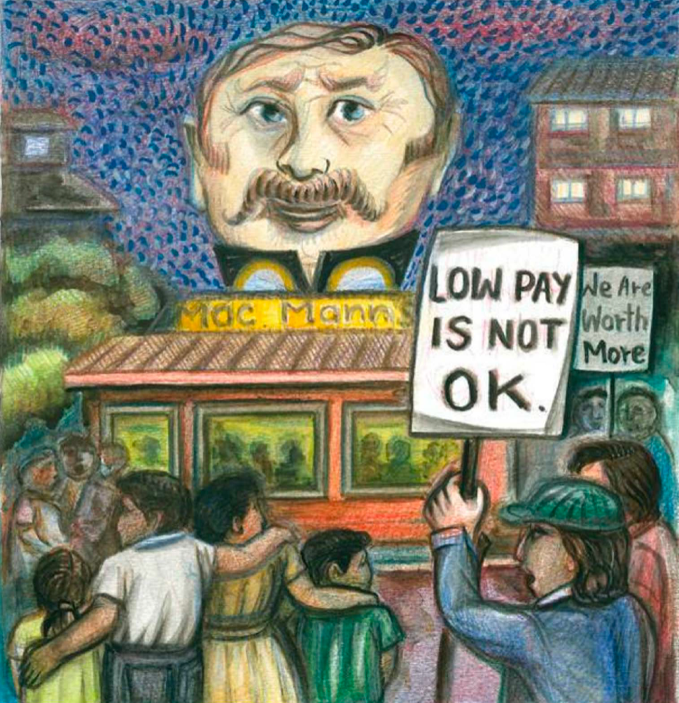
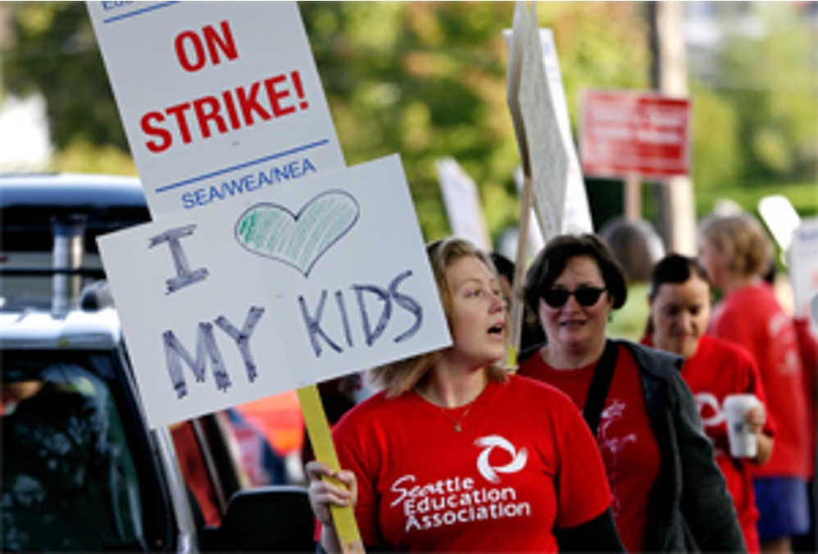
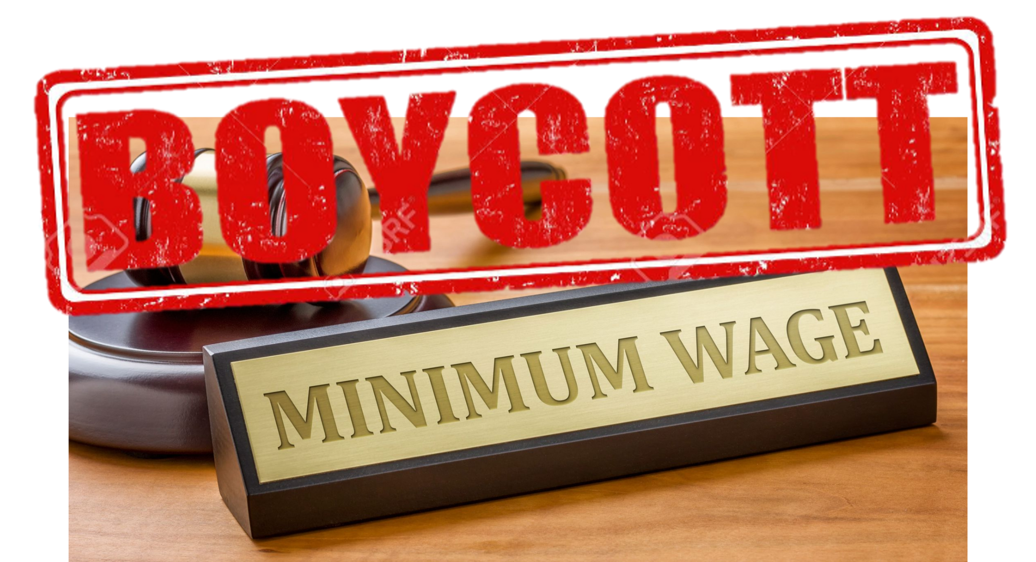

Rights Unit Vocabulary
Demonstrate
Strike
Boycott
Decision

Slide 4
Day 1: Words of the Day
Demonstrate
Strike

Slide 5
Demonstrate
Verb

Slide 6

Demonstrate
Have you heard this word
before?
What do you know about this
word?

Slide 7
In the book, the workers demonstrated
for better pay and a safer place to work.
Can you guess the meaning of
“demonstrate”?

Slide 8
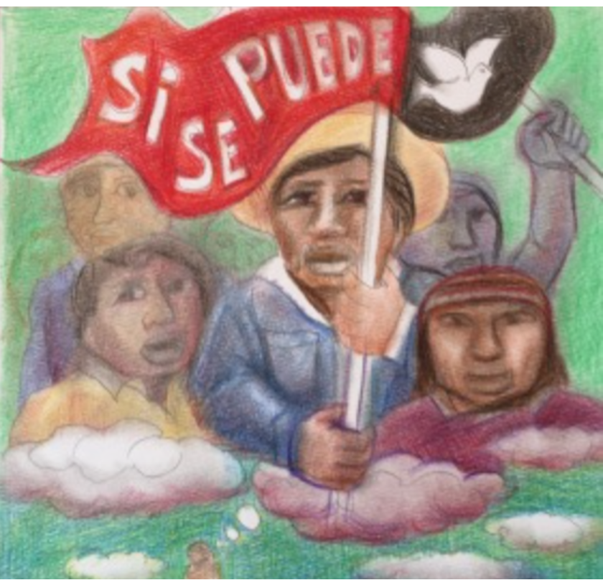
Demonstrate means to take
part in a public activity to show
support for or against a cause.
In Joelito's Big Decision, Mr. Thomas tells
Joelito that “Low-paid workers are
demonstrating all over the world today

Slide 9
Different Forms of Demonstrate
Demonstrating
Demonstration

Slide 10
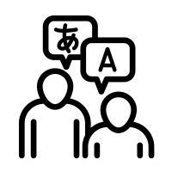


The Spanish
translation of
demonstrate is:
demostrar

Slide 11
The Mandarin
translation of
demonstrate is:
游 行 示 威
yóu xíng shì wēi

Slide 12

The Cantonese
translation of
demonstrate is:
遊 行 示 威
yau4 hang4 si6 wai1

Slide 13

Demonstrate (verb)
Do you know
how to say
demonstrate in
any other
languages?
Do you know
any synonyms
for the word
demonstrate?
Do you know
any antonyms
for the word
demonstrate?

Slide 14
Strike
Noun or Verb

Slide 15
Strike
Have you heard this word
before?
What do you know about
this word?

Slide 16
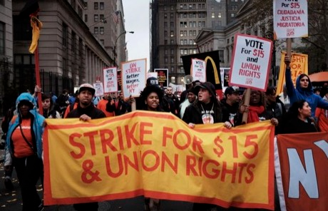
In 2015, low wage workers in NYC went on
strike because they wanted $15 per hour.
What are some different meanings of the
word “strike” that you know?

Slide 17
A strike is when workers refuse
to work because they are being
treated unfairly in their jobs.
Teachers in Seattle organized a strike because they wanted to make schools better for teachers and students. They asked the school district to increase recess by 30 minutes.

Slide 18
The Spanish
translation of
strike (noun) is:
huelga

Slide 19
The Spanish
translation of
strike (verb) is:
ponerse en
huelga

Slide 20
The Mandarin
translation of
strike is:
罢 工
bà gōng

Slide 21
The Cantonese
translation of
strike is:
罷 工
baa6 gung1

Slide 22
Strike (noun or verb)
Do you know
how to say
strike in any
other
languages?
Do you know
any
synonyms
for the word
strike?
Do you know
any
antonyms
for the word
strike?

Slide 23
Day 2: Words of the Day
Boycott
Decision

Slide 24
Boycott
Verb or Noun

Slide 25
Boycott
Have you heard this word
before?
What do you know about
this word?

Slide 26
Many people think we should boycott companies
who don't provide their workers with a living wage.
What do you think the word boycott might mean?
Use clues from the sentence to help you guess.

Slide 27
Boycott (verb) is to stop buying from
a business to protest their behaviors.
In Joelito's Big Decision, protestors asked
people to boycott MacMann’s restaurant because of how they treated their workers.

Slide 28
Boycott (noun) is the demonstration used by
people to protest the behaviors of a business.
The boycott at MacMann's restaurant
was started by the workers.

Slide 29
The Spanish
translation of
boycott (verb) is:
boicotear

Slide 30
The Spanish
translation of
boycott (noun) is:
boicoteo

Slide 31
The Mandarin
translation of
boycott is:
抵 制
dǐ zhì

Slide 32
The Cantonese
translation of
boycott is:
抵 制
dai2 zai3

Slide 33
Boycott (noun or verb)
Do you know
how to say
boycott in
any other
languages?
Do you know
any
synonyms
for the word
boycott?
Do you know
any
antonyms
for the word
boycott?

Slide 34
Decision
Noun

Slide 35
Decision
Have you heard this word
before?
What do you know about
this word?

Slide 36
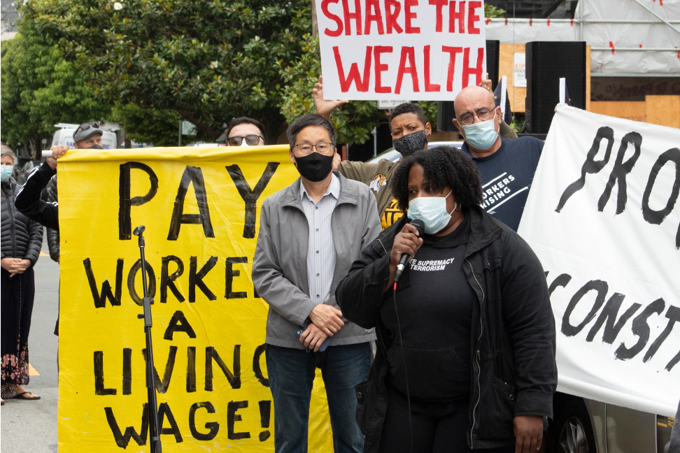
Joelito made a decision to join the Thomas
family to protest against low wages.
What other word do you see inside of the
word decision?

Slide 37
-sion:
TO TURN VERBS INTO NOUNS
Decide (verb): You decide something.
Decision (noun): You make a decision.

Slide 38
A decision is a choice made
after careful thinking.
Students' opinions are important.
School leaders should involve students
when making certain decisions about
education.

Slide 39
The Spanish
translation of
decision (noun) is:
decisión

Slide 40
The Mandarin
translation of
decision is:
决 定
jué dìng

Slide 41
The Cantonese
translation of
decision is:
決 定
kyut3 ding6

Slide 42
Decision (noun)
Do you know
how to say
decision in
any other
languages?
Do you know
any
synonyms
for the word
decision?
Do you know
any
antonyms
for the word
decision?

Slide 43
Time to Review
To take part in a public activity to show support for
or against a cause.
A strike is when workers refuse to work because they are being treated unfairly in their jobs.
To stop buying from a business to protest their
behaviors.
The demonstration used by people to protest the behaviors of a business.
A choice made after careful
thinking.
Demonstrate
Strike
Boycott (verb)
Boycott (noun)
Decision

Slide 44
Word Parts

Slide 45




Suffix
Meaning
Example
Other Words
Decision: A choice
made after careful
thinking.
- Vacation
- Demonstration
-tion/sion
Used to make nouns
A person who performs
an action
Demonstrator: A
person wh. takes part
in a public protest.
- Worker
- Inventor
-or/er

Slide 46
Connectives:
FANBOYS

Slide 47


Connective
(FANBOYS)
Sentence
Explanation
For
The kids decided to walk over to McMann's, for there
was a crowd gathered outside.
“For” gets us ready to understand why the kids walked
over to McMann's.
And
Joelito loves to eat burgers and fries.
“And” connects different words together.
Nor
Brandon's dad was not able to come to the soccer
game, nor was his mom.
“Nor” tells us that both Brandon's dad and mom were
not able to come to the game.
But
They heard mama calling them, but they kept moving
towards the restaurant door.
“But” tells us that there is a difference to look for.
Or
They had to choose between eating at McMann's or
eating at Cocina las Ollitas.
“Or” tells us that there is a choice that has to be made.
Yet
They looked everywhere for Kayla's backpack, yet
they could not find it.
“Yet” shows that there is a difference to look for.
So
Mr. and Mrs. Thomas lost their jobs at the factory, so
they moved to a one-bedroom apartment.
“So” lets us know that the first part of the sentence
caused the second part.

Slide 48
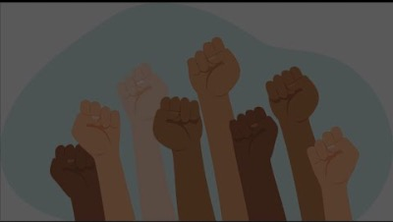
Fast Food Workers on Strike
Notes:
https://youtu.be/b7IEXr6KZs4

Slide 49

Want To Be A Youth Activist?
Notes:
https://www.youtube.com/watch?v=I1Fx3m2oPC4&t=199s

Slide 50
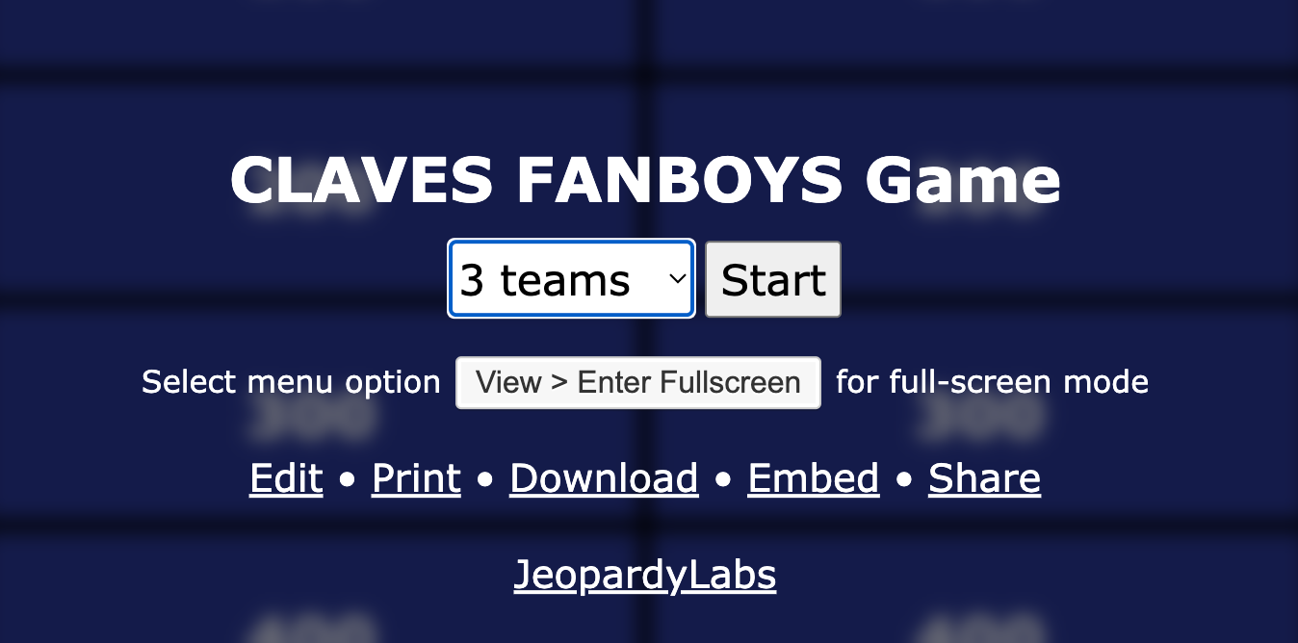
FANBOYS Jeopardy Game
https://jeopardylabs.com/play/claves-fanboys-game
Notes:
https://jeopardylabs.com/play/claves-fanboys-game

Slide 51
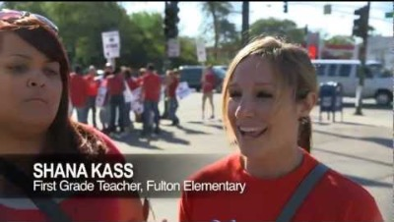
2012 Chicago Teacher Strike
Notes:
https://youtu.be/RjYglhZCXa4

Slide 52
Lesson Links
Lesson 3
Fast Food Workers on Strike
https://youtu.be/b7IEXr6KZs4
Lesson 4
Want to Be a Youth Activist?
https://www.youtube.com/watch?v=I1Fx3m2oPC4&t=199s
Lesson 5
FANBOYS Jeopardy Game
https://jeopardylabs.com/play/claves-fanboys-game
Lesson 6
Morphology Language Game
2012 Chicago Teacher Strike
https://www.youtube.com/watch?v=RjYglhZCXa4
1
2
3
4

