Slide 1
Nature Unit Cycle 1:
Wolves are Back

Slide 2
Question?
What do you know about national parks?
Have you ever been to a national park? What was it like?
2

Slide 3
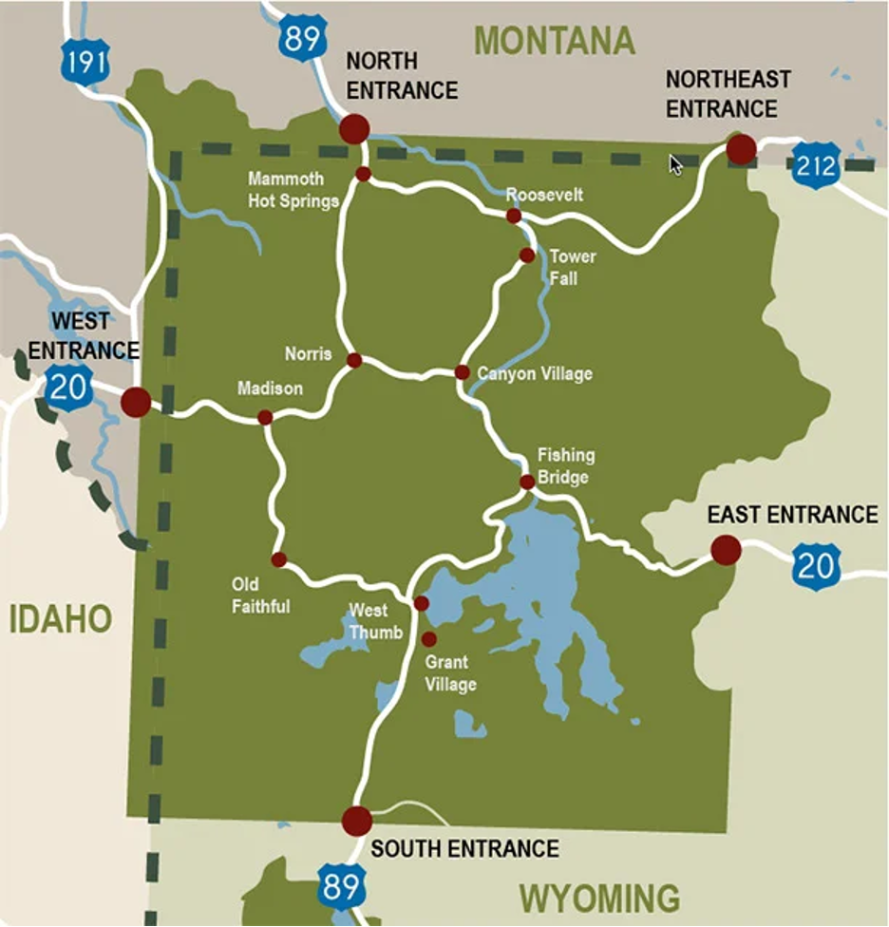
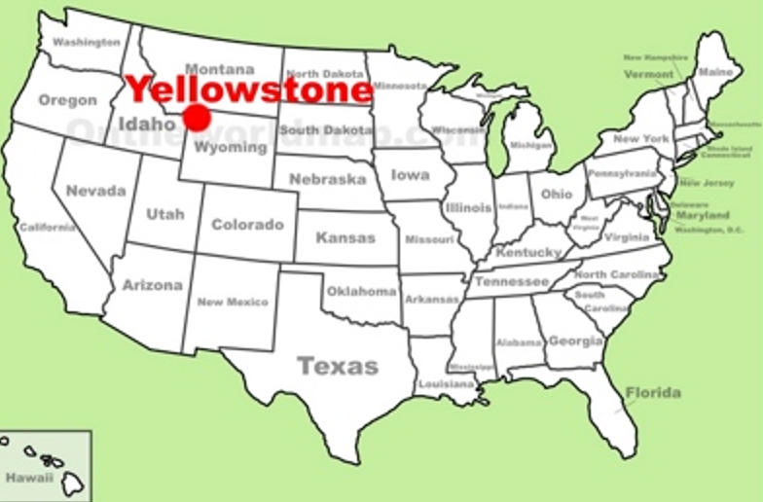
Yellowstone National Park is located in the western United States in Idaho, Montana, and Wyoming. It was the first national park in the United States.

Slide 4
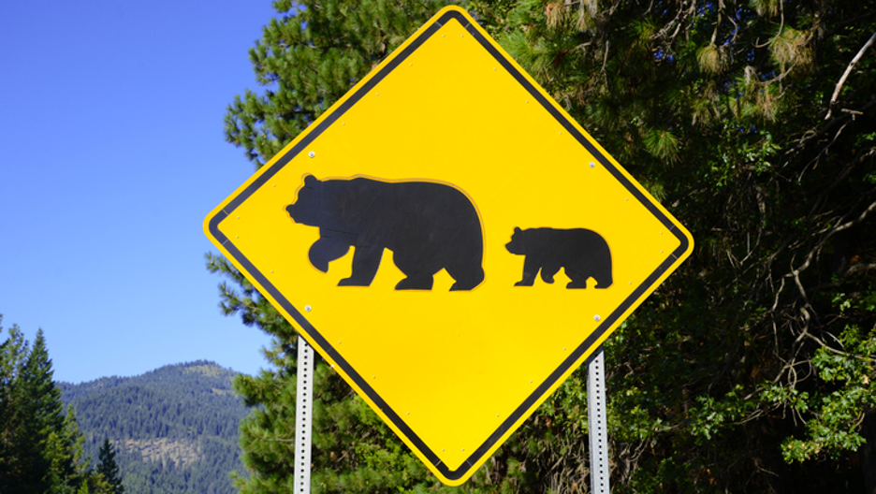
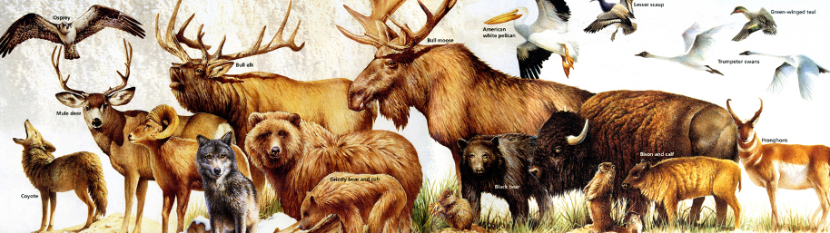
The park is known for its wildlife. Grizzly bears, wolves, bison, and elk live here. The park is also home to many endangered species.

Slide 5
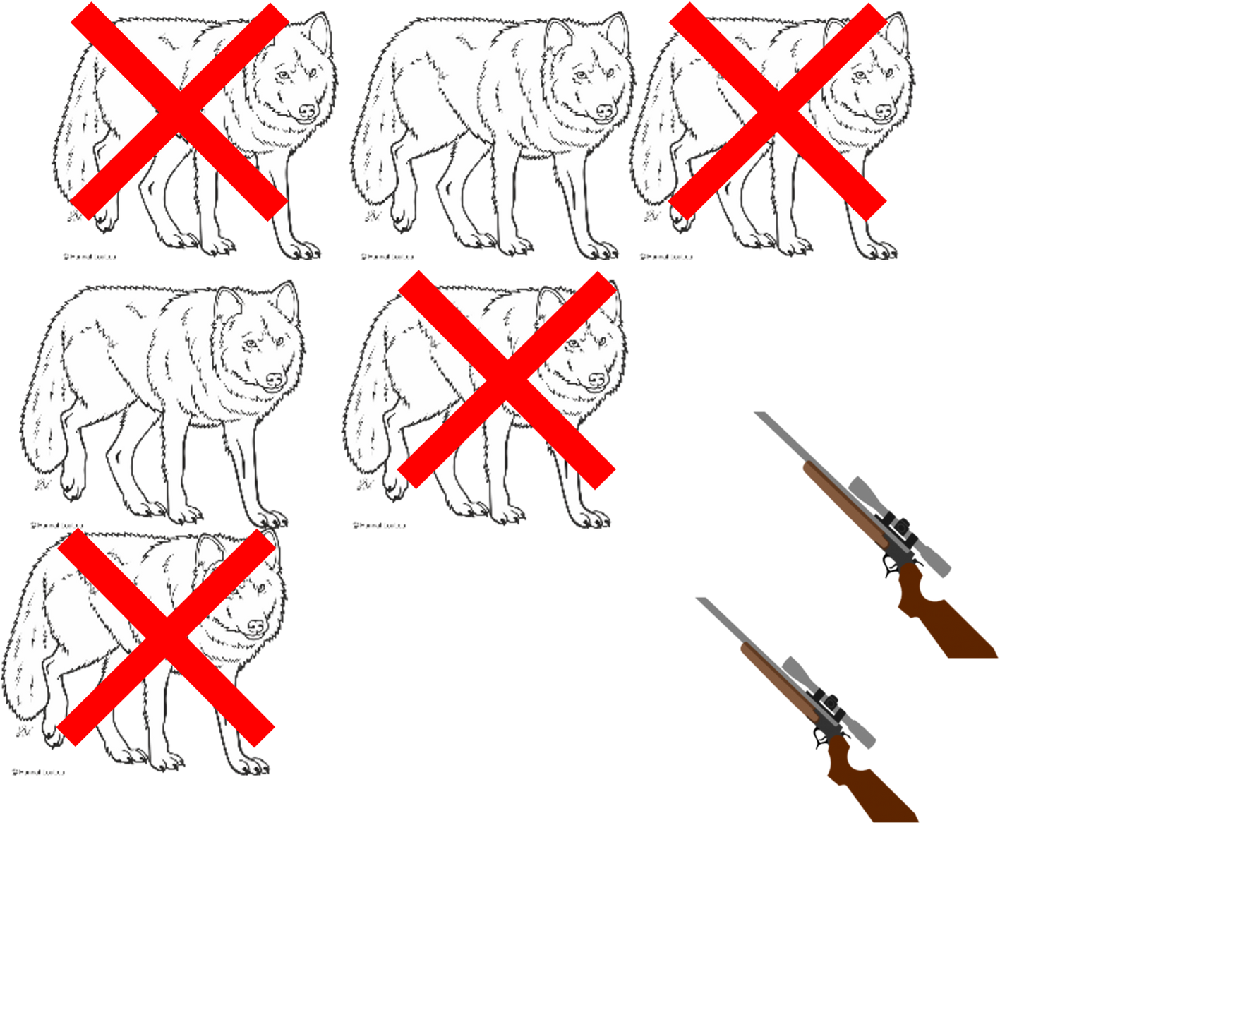
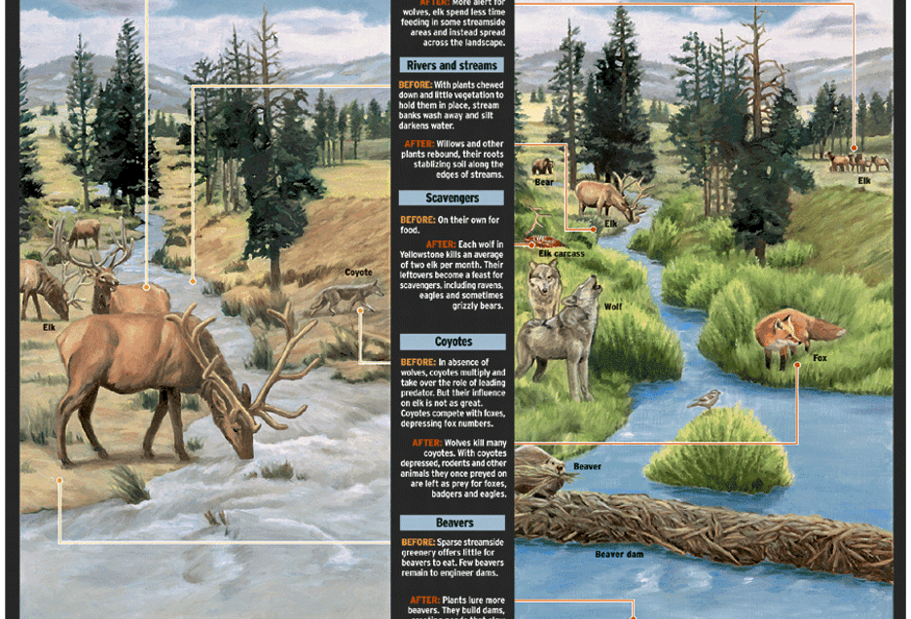
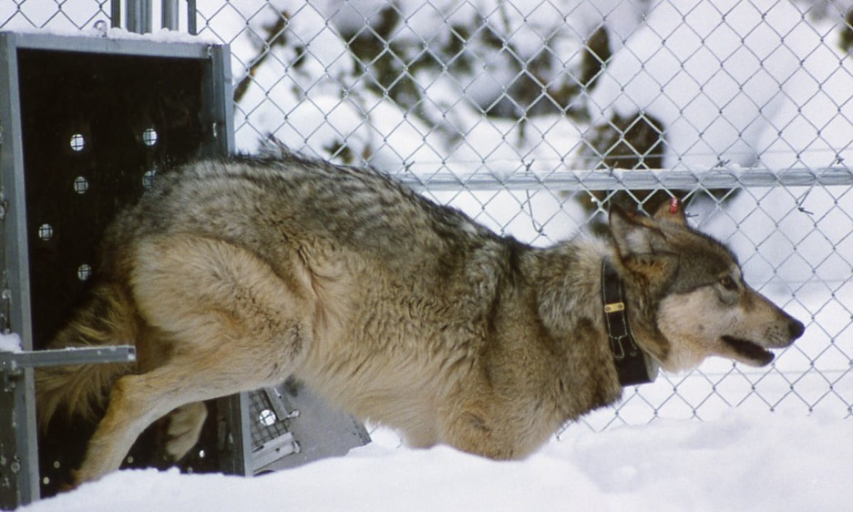
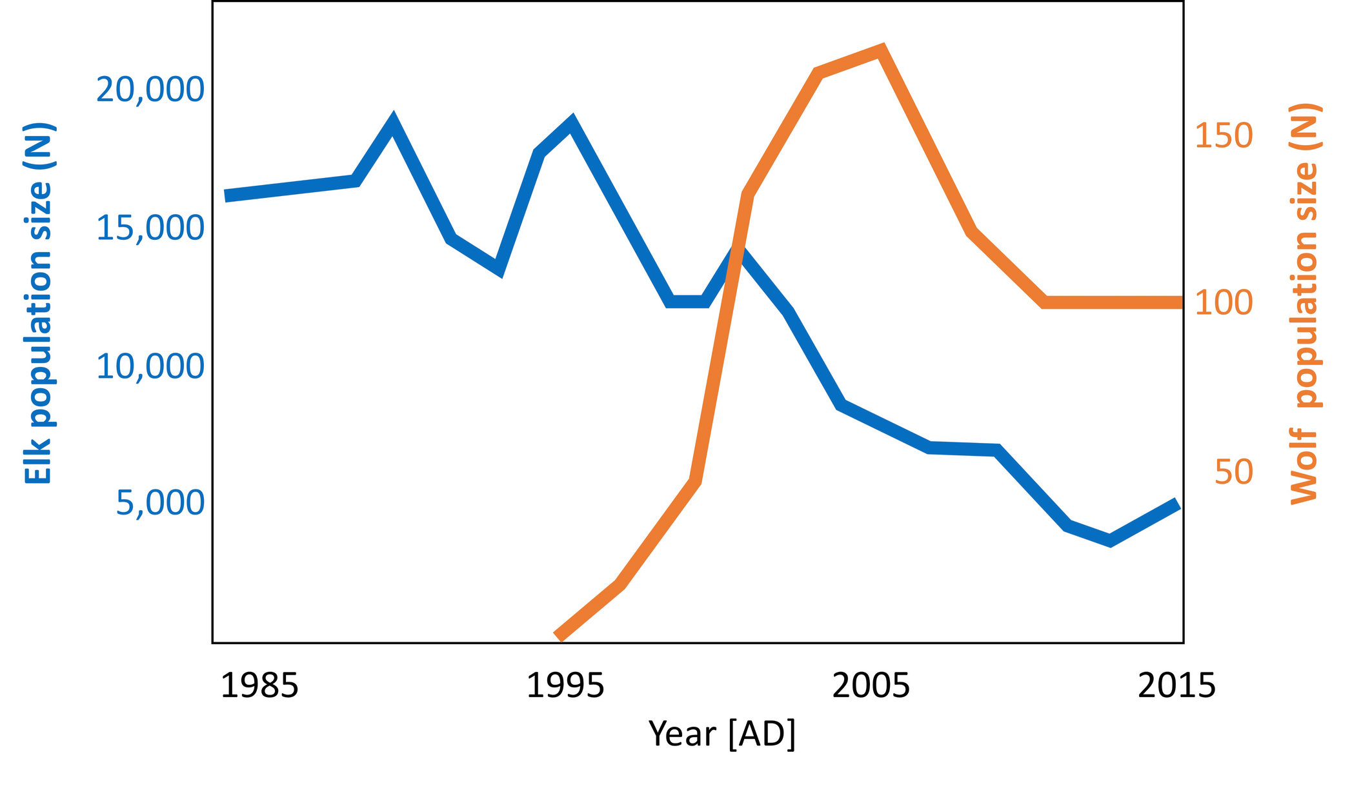
Nature Unit Vocabulary
Exterminate
Reintroduce
Depopulate
Restore

Slide 6
Day 1: Words of the Day
Exterminate
Reintroduce

Slide 7
Exterminate
Verb

Slide 8
Exterminate
Have you heard this word before?
What do you know about this word?

Slide 9
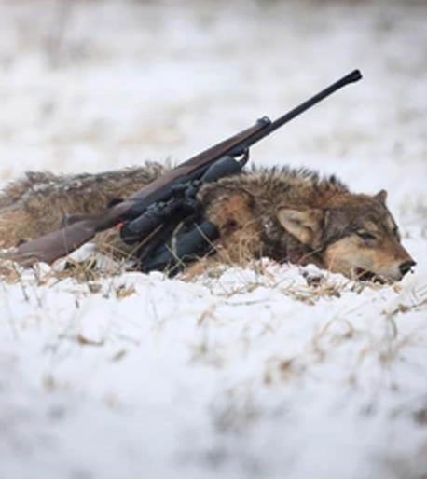
In The Wolves are Back, the Yellowstone wolves were shot and exterminated in the 1920s. Since then, there were no more wolves in the area.
What does the text say before and after the word that might give clues to its meaning?

Slide 10
Exterminate means to destroy or kill a group of animals or humans completely.
In The Wolves are Back, the Yellowstone wolves were shot and exterminated.

Slide 11
The Spanish translation of exterminate is:
exterminar

Slide 12
Exterminate
How is the Spanish cognate exterminar similar to or different from exterminate?

Slide 13
The Mandarin translation of exterminate is:

Slide 14
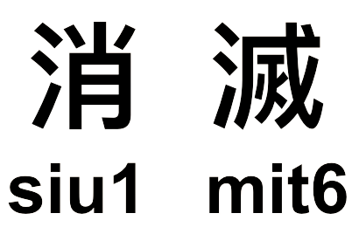
The Cantonese translation of exterminate is:

Slide 15
Exterminate
Do you know how to say this word in another language?
Do you know any synonyms for this word?

Slide 16
Reintroduce
Verb

Slide 17
Reintroduce
Have you heard this word before?
What do you know about this word?

Slide 18
Reintroduce
Re = again, back

Slide 19
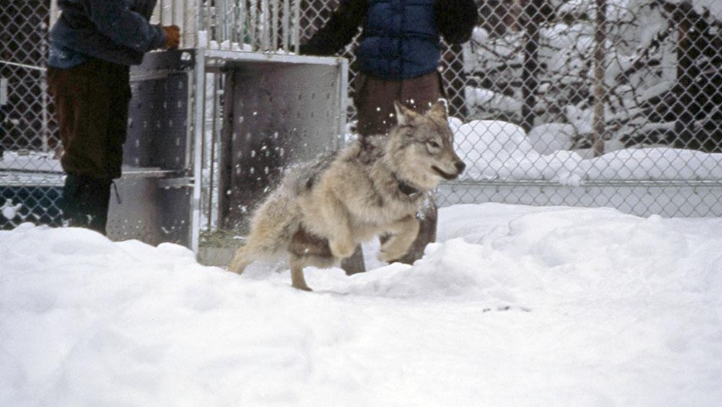
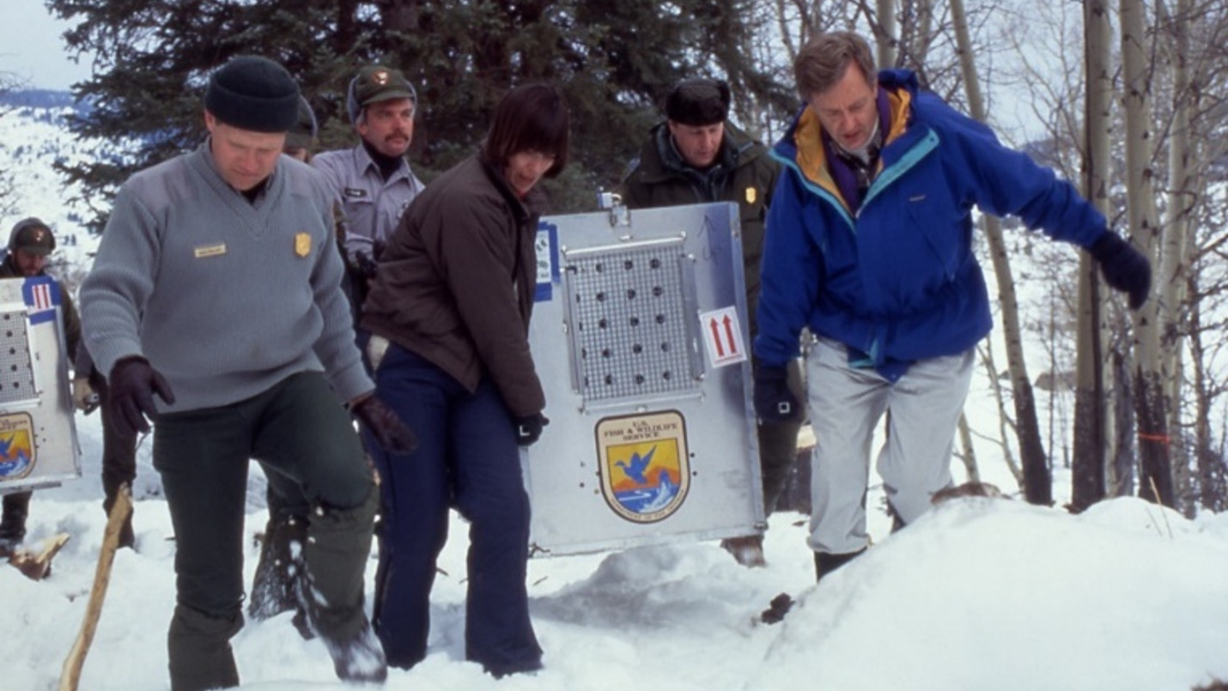
In The Wolves are Back, gray wolves were reintroduced into Yellowstone in 1995. After 70 years without wolves, people began to understand the important role of wolves in the ecosystem.
What does the text say before and after the word that might give clues to its meaning?

Slide 20
Reintroduce means to bring an animal or plant back again.
How does re- affect the meaning of the word introduce?

Slide 21
The Spanish translation of reintroduce is:
reintroducir

Slide 22
The Mandarin translation of reintroduce is:

Slide 23
The Mandarin translation of re = again, back:

Slide 24
The Cantonese translation of reintroduce is:

Slide 25
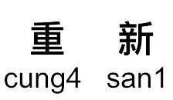
The Cantonese translation of re = again, back:

Slide 26
Reintroduce
Do you know how to say this word in another language?
Do you know any synonyms for this word?

Slide 27
Day 2: Words of the Day
Depopulate
Restore

Slide 28
Depopulate
Verb

Slide 29
Depopulate
Have you heard this word before?
What do you know about this word?

Slide 30
Depopulate
De = not or undo

Slide 31
Depopulate means to greatly reduce or decrease the number of animals in an area.
The depopulation of the wolves raised the number of elks in Yellowstone National Park. In this book, the wolves are depopulated from Yellowstone through extermination.

Slide 32
The Spanish translation of depopulate is:
despoblar

Slide 33
The Mandarin translation of depopulate is:

Slide 34
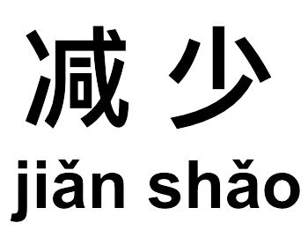
The Mandarin translation of de = not or undo:

Slide 35
The Cantonese translation of depopulate is:

Slide 36
The Cantonese translation of de = not or undo:

Slide 37
Restore
Verb

Slide 38
Restore
Have you heard this word before?
What do you know about this word?

Slide 39
Restore
What do you know about the prefix re-?
HINT: Reintroduce

Slide 40
Restore means to bring back someone, something, or someplace to the way it was.
At the end of The Wolves are Back, balance is restored in the wilderness.

Slide 41
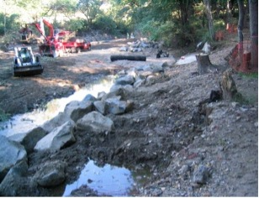
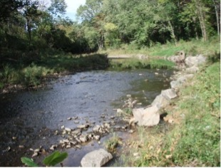
BEFORE
AFTER

Slide 42
The Spanish translation of restore is:
restaurar

Slide 43
The Mandarin translation of restore is:

Slide 44
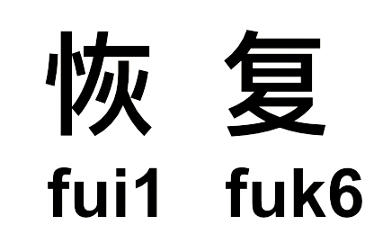
The Cantonese translation of restore is:

Slide 45
Time to Review
De-
Not or undo
Re-
To destroy or kill a group of animals or humans completely.
To bring an animal or plant back again.
To greatly reduce or decrease the number of animals in an area
To bring back someone, something, or someplace to the way it was.
Again, back
Exterminate
Reintroduce
Depopulate
Restore

Slide 46
Pronouns
I, You, He, She, It, We, They

Slide 47
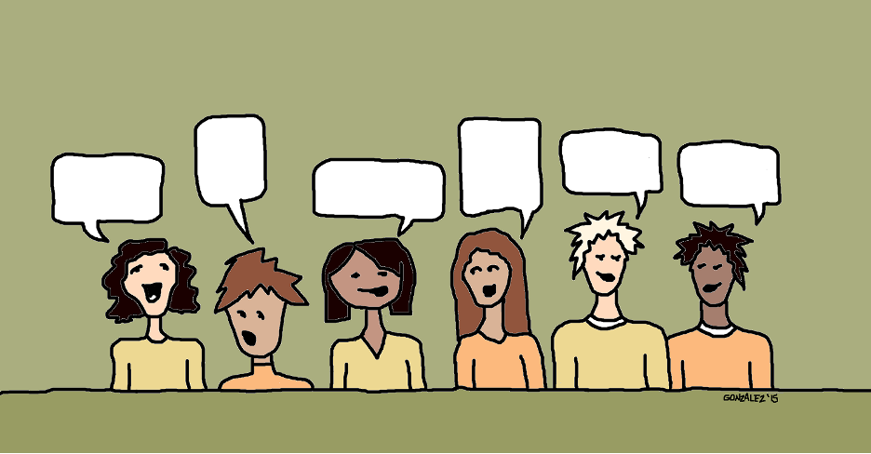
Discussion Norms
1
I am respectful of my classmates.
2
I listen carefully to the ideas my classmates are presenting.
3
I stick to the topic
4
I can talk without raising my hand.

Slide 48
Wolves and Ranchers
Notes:
https://www.youtube.com/watch?v=GoH2l8dHwlE

Slide 49
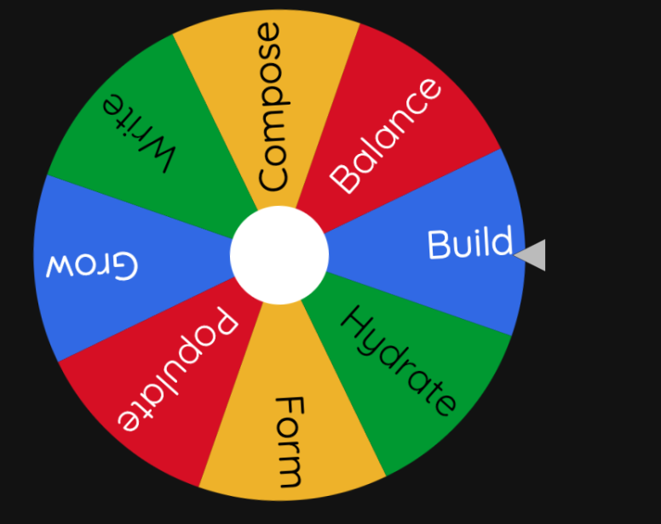
CLAVES Wheel of Morphology
https://wheelofnames.com/view/899-8ff/
Notes:
https://wheelofnames.com/view/899-8ff/

Slide 50
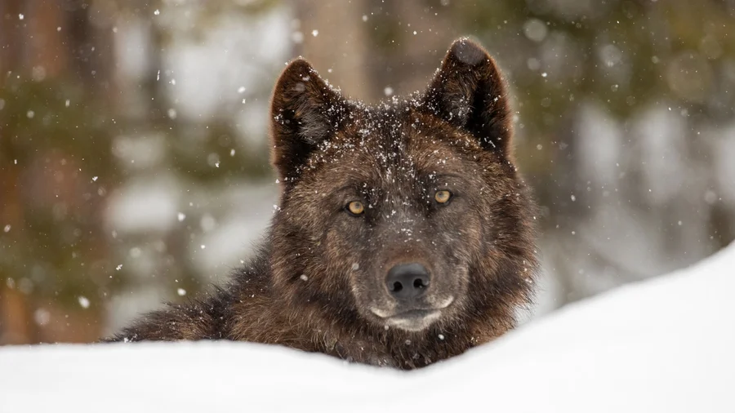
Wolves in the Wild
https://www.yellowstonepark.com/things-to-do/wildlife/wolf-reintroduction-changes-ecosystem/
Notes:
https://www.yellowstonepark.com/things-to-do/wildlife/wolf-reintroduction-changes-ecosystem/

Slide 51
Wolf Reintroduction
Notes:
https://www.youtube.com/watch?v=7fve66nkKy4

Slide 52
Lesson Links
Lesson 3
Wolves and Ranchers
https://www.youtube.com/watch?v=GoH2l8dHwlE
Lesson 4
CLAVES Wheel of Morphology
https://wheelofnames.com/view/899-8ff/
Lesson 6
Wolves in the Wild
https://www.yellowstonepark.com/things-to-do/wildlife/wolf-reintroduction-changes-ecosystem/
Wolves Reintroduction
https://www.youtube.com/watch?v=7fve66nkKy4
1
2
3
4

